Slide 1
Disjoint Sets
Chapter 8

Slide 2
Sets
Sets are made up of related items
We denote the relation with R
If a R b then a is related to b

Slide 3
Equivalence Relations
A relation that is:
Reflexive
a R a must always be true
Symmetric
If a R b
Then b R a
Transitive
If a R b and b R c
Then a R c

Slide 4
Equivalence Relations
Is liking/loving an equivalence relation?
A relation that is:
Reflexive
a R a must always be true
Symmetric
If a R b
Then b R a
Transitive
If a R b and b R c
Then a R c

Slide 5
Equivalence Relations
Is liking/loving an equivalence relation?
Not reflexive- some people don’t love themselves
Not symmetric- unrequited love
Not transitive- I can love a friend, and the friend loves another friend, but I may not love their other friend
A relation that is:
Reflexive
a R a must always be true
Symmetric
If a R b
Then b R a
Transitive
If a R b and b R c
Then a R c

Slide 6
Equivalence Relations
Is electrical connectivity an equivalence relation?
A relation that is:
Reflexive
a R a must always be true
Symmetric
If a R b
Then b R a
Transitive
If a R b and b R c
Then a R c

Slide 7
Equivalence Relations
Is electrical connectivity (through wire) an equivalence relation?
Reflexive- wire is connected to itself
Symmetric- connections go both ways
Transitive- connections can go through a series of wires
A relation that is:
Reflexive
a R a must always be true
Symmetric
If a R b
Then b R a
Transitive
If a R b and b R c
Then a R c

Slide 8
Equivalence Relations
Are roads connecting cities equivalence relations?
A relation that is:
Reflexive
a R a must always be true
Symmetric
If a R b
Then b R a
Transitive
If a R b and b R c
Then a R c

Slide 9
Equivalence Relations
Are roads connecting places equivalence relations?
Reflexive- a place is connected to itself
Not Symmetric- one way roads may allow passage from one to the other, but not back
Transitive- you can travel from a to b, then b to c, so you can travel from a to c
A relation that is:
Reflexive
a R a must always be true
Symmetric
If a R b
Then b R a
Transitive
If a R b and b R c
Then a R c

Slide 10
Equivalence Relations
Are familial relations equivalence relations?
A relation that is:
Reflexive
a R a must always be true
Symmetric
If a R b
Then b R a
Transitive
If a R b and b R c
Then a R c

Slide 11
Equivalence Relations
Are familial relations equivalence relations?
Reflexive- you are related to yourself
Symmetric- if you are related to someone, then they are also related to you
Transitive- I am related to my cousin (through my mom’s sister), she is related to her cousin on the other side (through her dad’s brother), but I am not related to her cousin
A relation that is:
Reflexive
a R a must always be true
Symmetric
If a R b
Then b R a
Transitive
If a R b and b R c
Then a R c

Slide 12
Relations in Sets
Given a set, everything in that set should have an equivalence relationship with everything else in that set ( denoted a~b )

Slide 13
Relations in Sets
Storage
Could store as a 2-d array of bools

Slide 14
Relations in Sets
Storage
Could store as a 2-d array of bools
This takes n*n space
Lets us determine relations in constant time
Often relations and sets are dynamic though
Also, we don’t need that much space, think of transitivity
If a ~ b and b ~ c and c ~ d, we can imply all other relations

Slide 15
Relations in Sets
We can store everything that is related in an equivalence class
Checking relations can be done by checking if they are in the same class.

Slide 16
Disjoint Sets
Disjoint sets are sets where
This means there are no common elements between sets

Slide 17
Disjoint Sets
Two main operations- Union and Find
Find- returns set, or equivalence class the element is in
Union- joins the equivalence classes

Slide 18
Disjoint Sets
Use find to determine if two elements are related
Call find on both elements
If the return values equal, then they are related
Otherwise, they are not related

Slide 19
Disjoint Sets
Use the union to combine sets
First, use find to see if they are already in the same set
Then, use the union to combine
Being able to combine sets makes these dynamic

Slide 20
Set Storage - Array
Make our storage an array
The index is the element id
The value is the set name
0 | 0
1 | 1
2 | 2
3 | 3
4 | 4
5 | 5
6 | 6
7 | 7
8 | 8
9 | 9
10 | 10
11 | 11

Slide 21
Set Storage - Array
Find returns the set name
Find (1)
Find (7)
What is the complexity?
0 | 0
1 | 1
2 | 2
3 | 3
4 | 4
5 | 5
6 | 6
7 | 7
8 | 8
9 | 9
10 | 10
11 | 11

Slide 22
Set Storage - Array
Find returns the set name
Find (1)
Find (7)
What is the complexity?
Constant
0 | 0
1 | 1
2 | 2
3 | 3
4 | 4
5 | 5
6 | 6
7 | 7
8 | 8
9 | 9
10 | 10
11 | 11

Slide 23
Set Storage - Array
Union joins them by first finding, then joining the second set to the first
Union(4, 1)
0 | 0
1 | 4
2 | 2
3 | 3
4 | 4
5 | 5
6 | 6
7 | 7
8 | 8
9 | 9
10 | 10
11 | 11

Slide 24
Set Storage - Array
After Union(4, 1)
Now Union(10, 7)
0 | 0
1 | 4
2 | 2
3 | 3
4 | 4
5 | 5
6 | 6
7 | 7
8 | 8
9 | 9
10 | 10
11 | 11

Slide 25
Set Storage - Array
After Union(10, 7)
Now Union(5, 11)
0 | 0
1 | 4
2 | 2
3 | 3
4 | 4
5 | 5
6 | 6
7 | 10
8 | 8
9 | 9
10 | 10
11 | 11

Slide 26
Set Storage - Array
After Union(5, 11)
Now Union(0, 4)
0 | 0
1 | 4
2 | 2
3 | 3
4 | 4
5 | 5
6 | 6
7 | 10
8 | 8
9 | 9
10 | 10
11 | 5

Slide 27
Set Storage - Array
After Union(0, 4)
What is the complexity?
0 | 0
1 | 0
2 | 2
3 | 3
4 | 0
5 | 5
6 | 6
7 | 10
8 | 8
9 | 9
10 | 10
11 | 5

Slide 28
Set Storage - Array
With the array, union is O(n) which is too slow
Use linked lists
Index is the name of the set
Linked list holds elements
0 | 0->1->4
1
2 | 2
3 | 3
4
5 | 5->11
6 | 6
7
8 | 8
9 | 9
10 | 10->7
11

Slide 29
Set Storage - Linked Lists
Now what is the complexity of Union?
0 | 0->1->4
1
2 | 2
3 | 3
4
5 | 5->11
6 | 6
7
8 | 8
9 | 9
10 | 10->7
11

Slide 30
Set Storage - Linked Lists
Now what is the complexity of Union?
If keep an end pointer, O(1) to union
0 | 0->1->4
1
2 | 2
3 | 3
4
5 | 5->11
6 | 6
7
8 | 8
9 | 9
10 | 10->7
11

Slide 31
Set Storage - Linked Lists
Now what is the complexity of Find?
0 | 0->1->4
1
2 | 2
3 | 3
4
5 | 5->11
6 | 6
7
8 | 8
9 | 9
10 | 10->7
11

Slide 32
Set Storage - Linked Lists
Now what is the complexity of Union?
O(n)
This actually makes the union O(n) too, because it first calls find
0 | 0->1->4
1
2 | 2
3 | 3
4
5 | 5->11
6 | 6
7
8 | 8
9 | 9
10 | 10->7
11

Slide 33
Set Storage - Forests
We can use forests!
Find will return the name of the original parent
Union will attach one tree to the other

Slide 34

Set Storage - Forests
Find (6)
Find (0)
Find (1)

Slide 35
Set Storage - Forests
Union (1, 0)
Union(6, 4)

Slide 36
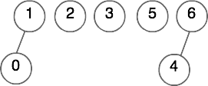
Set Storage - Forests
Find (6)
Find (0)
Find (1)

Slide 37
Set Storage - Forests
Union (6, 1)
Union (1, 3)

Slide 38
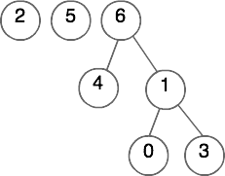
Set Storage - Forests
After Union (6, 1) and Union (1, 3)

Slide 39
Set Storage - Forests
What is the complexity of Find?

Slide 40
Set Storage - Forests
What is the complexity of Find?
O(n) if you know where the node is

Slide 41
Set Storage - Forests
What is the complexity of Union?

Slide 42
Set Storage - Forests
What is the complexity of Union?
O(1) if you know where the nodes are to do the union
O(n) because it calls find

Slide 43
Set Storage - Forests
How do you store a forest?

Slide 44
Set Storage - Forests
How do you store a forest?
Use an array of Trees
Or, since we really only need to find parents, the forests can be implemented as arrays

Slide 45
Set Storage – Forest array
Find (6)
Find (0)
Find (1)
0 | -1
1 | -1
2 | -1
3 | -1
4 | -1
5 | -1
6 | -1

Slide 46
Set Storage – Forest array
Union (1, 0)
Union(6, 4)
0 | -1
1 | -1
2 | -1
3 | -1
4 | -1
5 | -1
6 | -1

Slide 47
Set Storage – Forest array
Find (6)
Find (0)
Find (1)
0 | 1
1 | -1
2 | -1
3 | -1
4 | 6
5 | -1
6 | -1

Slide 48
Set Storage – Forest array
Union (6, 1)
Union (1, 3)
0 | 1
1 | -1
2 | -1
3 | -1
4 | 6
5 | -1
6 | -1

Slide 49
Set Storage – Forest array
After Union (6, 1) and Union (1, 3)
0 | 1
1 | 6
2 | -1
3 | 1
4 | 6
5 | -1
6 | -1

Slide 50
Set Storage – Forest array
How do I write a find?
0 | 1
1 | 6
2 | -1
3 | 1
4 | 6
5 | -1
6 | -1

Slide 51
Set Storage – Forest array
How do I write a find?
int find(int ind){
if(sets[ind]== -1)
return ind;
return find(sets[ind]);
}
0 | 1
1 | 6
2 | -1
3 | 1
4 | 6
5 | -1
6 | -1

Slide 52
Set Storage – Forest array
How do I write a union?
0 | 1
1 | 6
2 | -1
3 | 1
4 | 6
5 | -1
6 | -1

Slide 53
Set Storage – Forest array
How do I write a union?
void union(int ind1, int ind2){
if( find(ind1) != find(ind2) )
sets [ ind2 ]=ind1;
}
0 | 1
1 | 6
2 | -1
3 | 1
4 | 6
5 | -1
6 | -1

Slide 54
Set Storage – Forest array
Find is O(n)
Union is O(1) for union work, O(n) overall because it calls the find
0 | 1
1 | 6
2 | -1
3 | 1
4 | 6
5 | -1
6 | -1

Slide 55
Smarter Unions
We want the tree to be short to save on find time
What if we union the roots?
Union(3, 5)

Slide 56
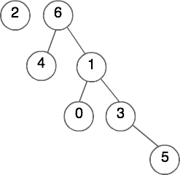
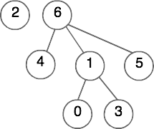
Smarter Unions
We want the tree to be short to save on find time
What if we union the roots?
After Union(3, 5) we get this: Instead of this:

Slide 57
Smarter Unions
We want the tree to be short to save on find time
What if we attach the smaller tree to the larger one?
Union(5, 6)

Slide 58
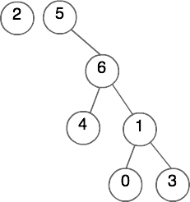
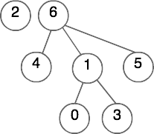
Smarter Unions
Union(5, 6) – the typical union added to the height, the smart union didn’t

Slide 59
Smarter Unions
This is called union by size
In the array, the root keeps track of size
When unioning, add the sizes

Slide 60
Smarter Unions
Union by size
Union (5, 6)
0 | 1
1 | 6
2 | -1
3 | 1
4 | 6
5 | -1
6 | -5

Slide 61
Smarter Unions
Union by Size
After Union (5, 6)
0 | 1
1 | 6
2 | -1
3 | 1
4 | 6
5 | 6
6 | -6

Slide 62
Smarter Unions
Union by Size
Worst Case depth is log n
Makes Find O(log n)
Union stays O(1) for unioning part
Union is O(log n) because it calls find
0 | 1
1 | 6
2 | -1
3 | 1
4 | 6
5 | 6
6 | -6

Slide 63
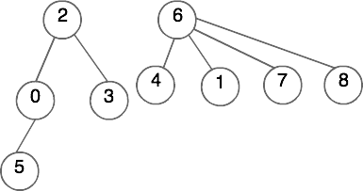
Smarter Unions
Union by Size may not always prevent us from adding depth
Consider Union (2, 6)
0 | 2
1 | 6
2 | -4
3 | 2
4 | 6
5 | 0
6 | -5
7 | 6
8 | 6

Slide 64
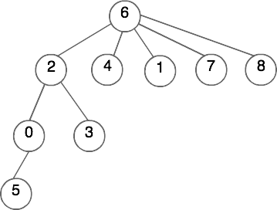
Smarter Unions
Result of Union (2, 6) added a level
0 | 2
1 | 6
2 | 6
3 | 2
4 | 6
5 | 0
6 | -9
7 | 6
8 | 6

Slide 65
Smarter Unions
What could we do instead?
0 | 2
1 | 6
2 | -4
3 | 2
4 | 6
5 | 0
6 | -5
7 | 6
8 | 6

Slide 66
Smarter Unions
What could we do instead?
Store the height, and union by height
Union(2, 6)
0 | 2
1 | 6
2 | -3
3 | 2
4 | 6
5 | 0
6 | -2
7 | 6
8 | 6

Slide 67
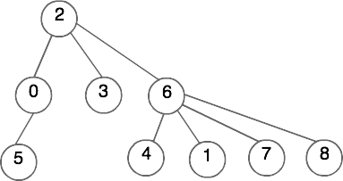
Smarter Unions
Union by Height
Result of Union(2, 6)
0 | 2
1 | 6
2 | -3
3 | 2
4 | 6
5 | 0
6 | 2
7 | 6
8 | 6

Slide 68
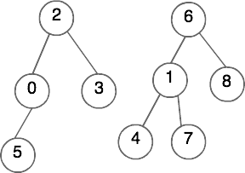
Smarter Unions
Union by Height will add a level if the trees are the same height
Union(2, 6)
0 | 2
1 | 6
2 | -3
3 | 2
4 | 1
5 | 0
6 | -3
7 | 1
8 | 6

Slide 69
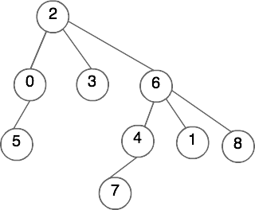
Path Compression
Cut down the the height
When we do a find, we visit every node on the way up the tree
int find(int index){
if(sets[index]== -1)
return index;
return find(sets[index]);
}

Slide 70
Path Compression
When we do a find, we already have to visit every node on the way up the tree
Why don’t we do a little extra work and attach them straight to the root as we work back out?
Find(7)

Slide 71
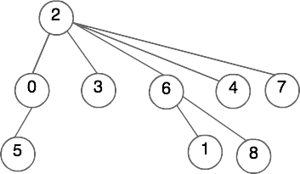
Path Compression
After Find(7) using path compression

Slide 72
Path Compression
int find(int ind){
if(sets[ind]== -1)
return ind;
sets[ind]=find(sets[ind]);
return sets[ind];
}
0 | 2
1 | 6
2 | -4
3 | 2
4 | 6
5 | 0
6 | 2
7 | 4
8 | 6

Slide 73
Path Compression
int find(int ind){
if(sets[ind]== -1)
return ind;
sets[ind]=find(sets[ind]);
return sets[ind];
}
0 | 2
1 | 6
2 | -4
3 | 2
4 | 2
5 | 0
6 | 2
7 | 2
8 | 6

Slide 74
Path Compression
Path compression shortens the tree
This helps successive find operations be faster

Slide 75
Path Compression
Will this work with union by size?
0 | 2
1 | 6
2 | -4
3 | 2
4 | 6
5 | 0
6 | -5
7 | 6
8 | 6

Slide 76
Path Compression
Will this work with union by size?
Yes, because it doesn’t change the size of the tree
0 | 2
1 | 6
2 | -4
3 | 2
4 | 6
5 | 0
6 | -5
7 | 6
8 | 6

Slide 77
Path Compression
Will this work with union by height?
0 | 2
1 | 6
2 | -4
3 | 2
4 | 6
5 | 0
6 | -5
7 | 6
8 | 6

Slide 78
Path Compression
Will this work with union by height?
No, because there is no good way to know what the height is afterwards
0 | 2
1 | 6
2 | -4
3 | 2
4 | 6
5 | 0
6 | -5
7 | 6
8 | 6

Slide 79
Path Compression
What can we do about this?
0 | 2
1 | 6
2 | -4
3 | 2
4 | 6
5 | 0
6 | -5
7 | 6
8 | 6

Slide 80
Path Compression
What can we do about this?
We can just leave the heights and have it be an estimated height
This is also known as a rank, so we call it Union by Rank
Amortized analysis of union by rank is almost constant
0 | 2
1 | 6
2 | -4
3 | 2
4 | 6
5 | 0
6 | -5
7 | 6
8 | 6

Slide 81
Disjoint Set Uses
Why might this be useful?

Slide 82
Disjoint Set Uses
Why might this be useful?
We can store relations, like connectivity

Slide 83
Disjoint Set Uses
Consider a Maze
A good maze should only have one correct path
There should be no loops

Slide 84
Disjoint Set Uses
Consider a Maze
These are very time consuming to create by hand
But, we can have the computer generate them
How do we enforce no loops?
How do we enforce only one correct path?

Slide 85
Disjoint Set - Maze
Use a disjoint set!
Start by giving all cells an id
This will correspond to your array/sets
Put walls everywhere, making everything in its own set

Slide 86

Disjoint Set- Maze
Now, choose a random wall
If the two cells are not in the same set, Union them and knock down the wall

Slide 87
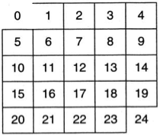

Disjoint Set- Maze
If I chose the wall between cell 0 and cell 1, my maze and sets would look like:

Slide 88
Disjoint Set- Maze
Continue knocking down walls until the beginning and end are connected (jn the same set)
After a series of knock downs it looks like:

Slide 89
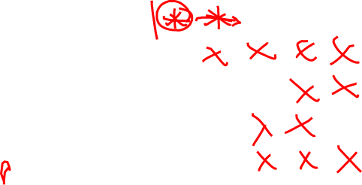
Disjoint Set- Maze
The final result:

Slide 90
Maze
Your next assignment is a maze
You will need to use a disjoint set
Runtime is dominated by union and find costs, so we’ll want the most efficient methods

Slide 91
Maze
Your next assignment is a maze
You will need to use a disjoint set
Runtime is dominated by union and find costs, so we’ll want the most efficient methods
Find with path compression
Union by rank

